Slide 1
Vector Mechanics For Engineers: Dynamics Twelfth Edition
Copyright © 2020 McGraw Hill , All Rights Reserved.
PROPRIETARY MATERIAL © 2020 The McGraw Hill Inc. All rights reserved. No part of this PowerPoint slide may be displayed, reproduced or distributed in any form or by any means, without the prior written permission of the publisher, or used beyond the limited distribution to teachers and educators permitted by McGraw Hill for their individual course preparation. If you are a student using this PowerPoint slide, you are using it without permission.

Slide 2
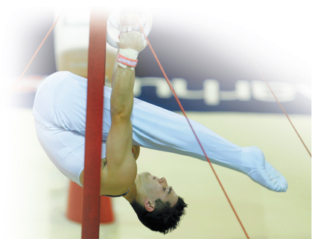
Chapter 17
Plane Motion of Rigid Bodies: Energy and Momentum Methods

Slide 3
Contents
Introduction
Principle of Work and Energy
Work of Forces Acting on a Rigid Body
Kinetic Energy of a Rigid Body in Plane Motion
Systems of Rigid Bodies
Conservation of Energy
Power
Sample Problem 17.1
Sample Problem 17.2
Sample Problem 17.3
Sample Problem 17.4
Sample Problem 17.6
Principle of Impulse and Momentum
Systems of Rigid Bodies
Conservation of Angular Momentum
Sample Problem 17.7
Sample Problem 17.8
Sample Problem 17.9
Eccentric Impact
Sample Problem 17.11
Sample Problem 17.13
Sample Problem 17.14

Slide 4
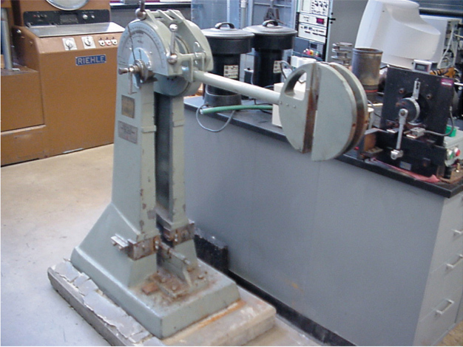
Introduction 1
A Charpy impact test is used to determine the amount of energy absorbed by a material during impact.
To determine the amount of energy absorbed, the final gravitational potential energy of the arm is subtracted from its initial gravitational potential energy.
© Philip Cornwell

Slide 5
Introduction 2
Method of work and energy and the method of impulse and momentum will be used to analyze the plane motion of rigid bodies and systems of rigid bodies.
Principle of work and energy is well suited to the solution of problems involving displacements and velocities.
Principle of impulse and momentum is appropriate for problems involving velocities and time.
Problems involving eccentric impact are solved by supplementing the principle of impulse and momentum with the application of the coefficient of restitution.

Slide 6
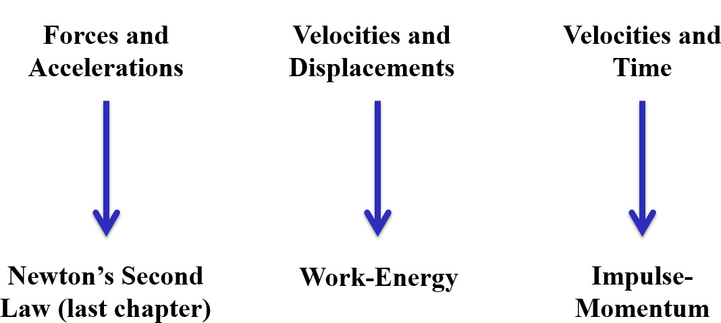
Introduction 3
Approaches to Rigid Body Kinetics Problem

Slide 7
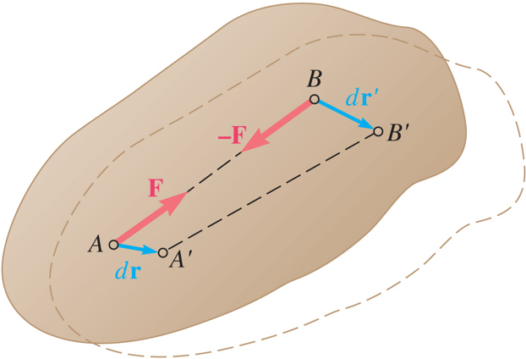
Principle of Work and Energy
Work and kinetic energy are scalar quantities.
Assume that the rigid body is made of a large number of particles.
initial and final total kinetic energy of particles forming body
total work of internal and external forces acting on particles of body.
Internal forces between particles A and B are equal and opposite.
Therefore, the net work of internal forces is zero.

Slide 8
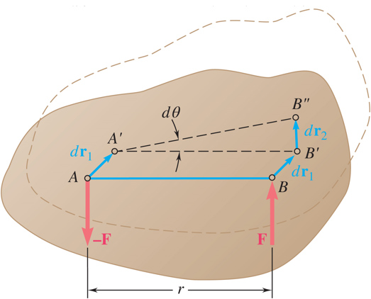
Work of Forces Acting on a Rigid Body 1
Work of a force during a displacement of its point of application,
Consider the net work of two forces
forming a couple of moment
during a
displacement of their points of application.
if M is constant.

Slide 9
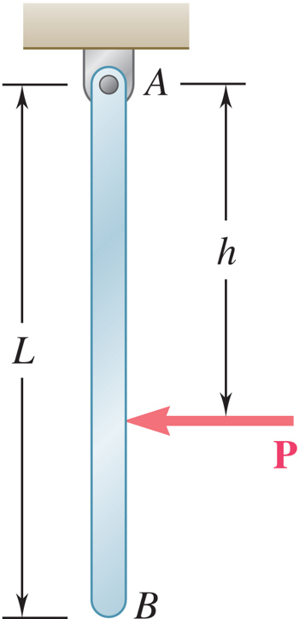
Work of Forces Acting on a Rigid Body 2
Do the pin forces at point A do work?
YES
NO
Does the force P do work?
YES
NO

Slide 10
Work of Forces Acting on a Rigid Body 3
Do the pin forces at point A do work?
YES
NO
Does the force P do work?
YES
NO

Slide 11
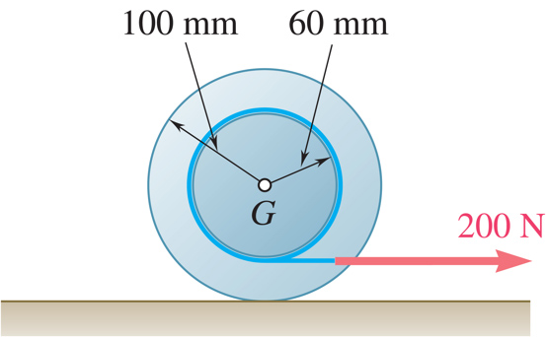
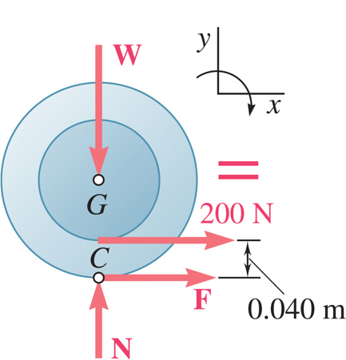
Work of Forces Acting on a Rigid Body 4
Does the normal force N do work on the disk?
YES
NO
Does the weight W do work?
YES
NO
If the disk rolls without slip, does the friction force F do work?
YES
NO

Slide 12
Work of Forces Acting on a Rigid Body 5
Does the normal force N do work on the disk?
YES
NO
Does the weight W do work?
YES
NO
If the disk rolls without slip, does the friction force F do work?
YES
NO

Slide 13
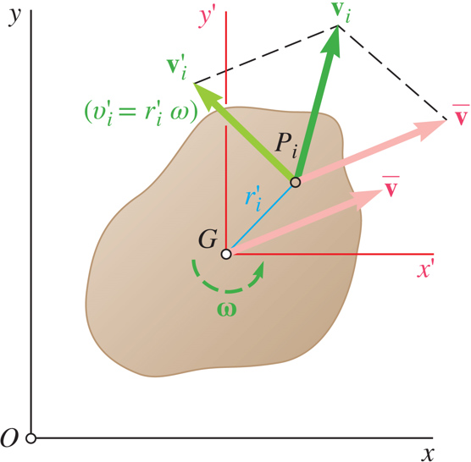
Kinetic Energy of a Rigid Body in Plane Motion 1
Consider a rigid body of mass m in plane motion consisting of individual particles i. The kinetic energy of the body can then be expressed as:
Kinetic energy of a rigid body can be separated into:
the kinetic energy associated with the motion of the mass center G and
the kinetic energy associated with the rotation of the body about G.
Translation + Rotation

Slide 14
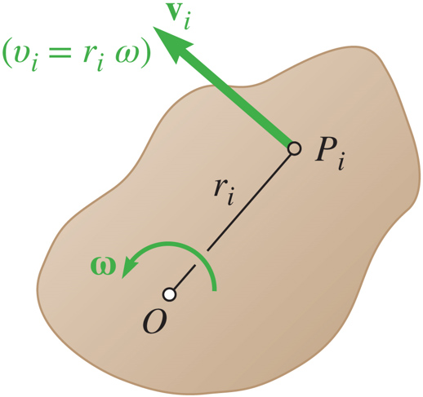
Kinetic Energy of a Rigid Body in Plane Motion 2
Consider a rigid body rotating about a fixed axis through O.
This is equivalent to using:
Remember to only use
when O is a fixed axis of rotation

Slide 15
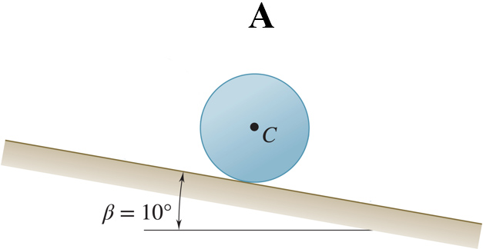
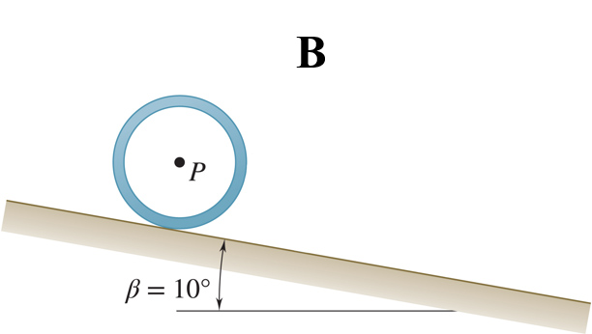
Concept Quiz 1
The solid cylinder A and the pipe B have the same diameter and mass. If they are both released from rest at the top of the hill, which will reach the bottom the fastest?
A will reach the bottom first
B will reach the bottom first
They will reach the bottom at the same time
Which will have the greatest kinetic energy when it reaches the bottom?
a) Cylinder A
b) Pipe B
c) Same kinetic energy

Slide 16
Concept Quiz 2
The solid cylinder A and the pipe B have the same diameter and mass. If they are both released from rest at the top of the hill, which will reach the bottom the fastest?
A will reach the bottom first
B will reach the bottom first
They will reach the bottom at the same time
Which will have the greatest kinetic energy when it reaches the bottom?
a) Cylinder A
b) Pipe B
c) Same kinetic energy

Slide 17
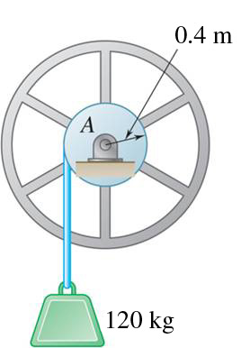
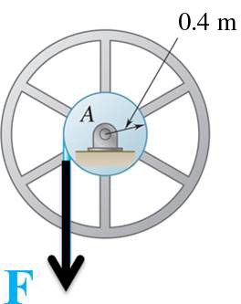
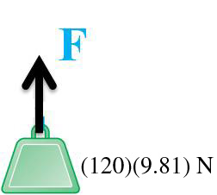
Systems of Rigid Bodies 1
For problems involving systems consisting of several rigid bodies, the principle of work and energy can be applied to each body.
We may also apply the principle of work and energy to the entire system,
T₁,T₂ = arithmetic sum of the kinetic energies of all bodies forming the system
U_{1→ 2} = work of all forces acting on the various bodies, whether these forces are internal or external to the system as a whole.

Slide 18
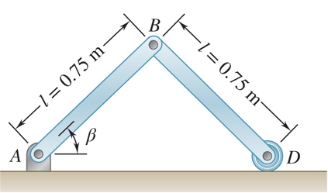
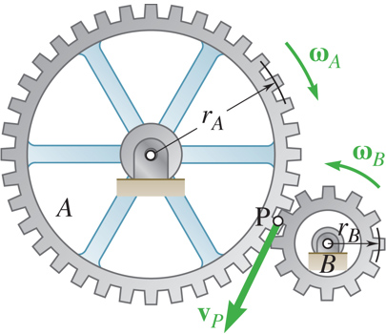
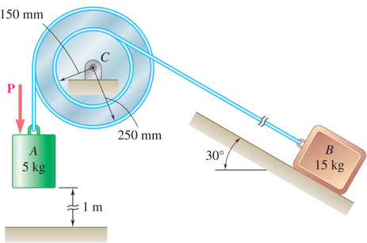
Systems of Rigid Bodies 2
For problems involving pin connected members, blocks and pulleys connected by inextensible cords, and meshed gears,
internal forces occur in pairs of equal and opposite forces
points of application of each pair move through equal distances
net work of the internal forces is zero
work on the system reduces to the work of the external forces

Slide 19
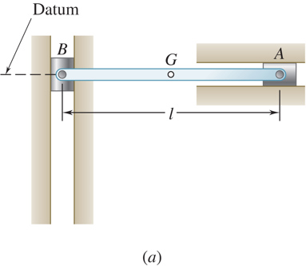
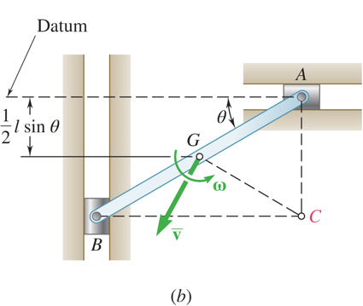
Conservation of Energy
Expressing the work of conservative forces as a change in potential energy, the principle of work and energy becomes
Consider the slender rod of mass m.
mass m
released with zero velocity
determine w at q

Slide 20
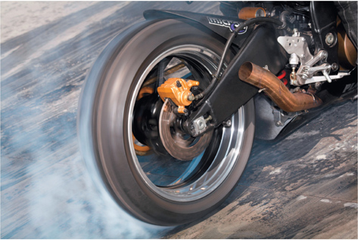
Power
Power = rate at which work is done
For a body acted upon by force
and moving with velocity
For a rigid body rotating with an angular velocity
and acted
upon by a couple of moment
parallel to the axis of rotation,
© Richard McDowell/Alamy RF

Slide 21
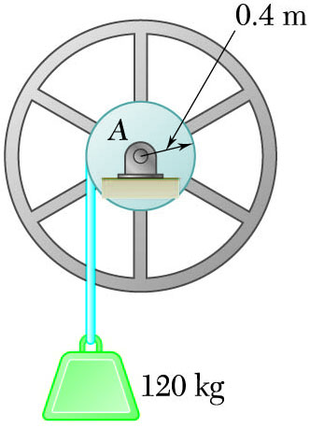
Sample Problem 17.1 1
Strategy:
Consider the system of the flywheel and block. The work done by the internal forces exerted by the cable cancels.
Note that the velocity of the block and the angular velocity of the drum and flywheel are related by
For the drum and flywheel,
The bearing friction is equivalent to a couple of At the instant shown, the block is moving downward at 2 m/s.
Apply the principle of work and kinetic energy to develop an expression for the final velocity.
Determine the velocity of the block after it has moved 1.25 m downward.

Slide 22
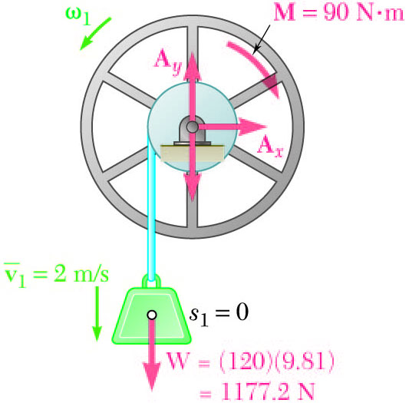
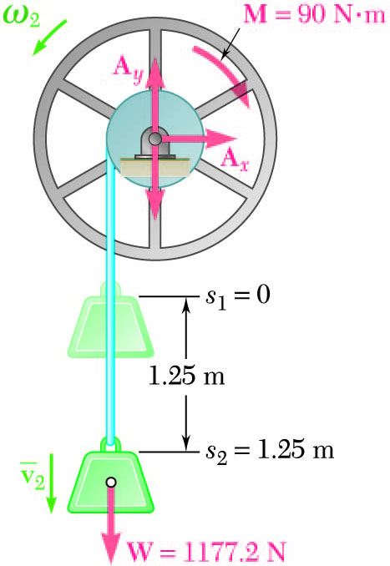
Sample Problem 17.1 2
Modeling and Analysis:
Consider the system of the flywheel and block. The work done by the internal forces exerted by the cable cancels.
Note that the velocity of the block and the angular velocity of the drum and flywheel are related by
Apply the principle of work and kinetic energy to develop an expression for the final velocity.

Slide 23
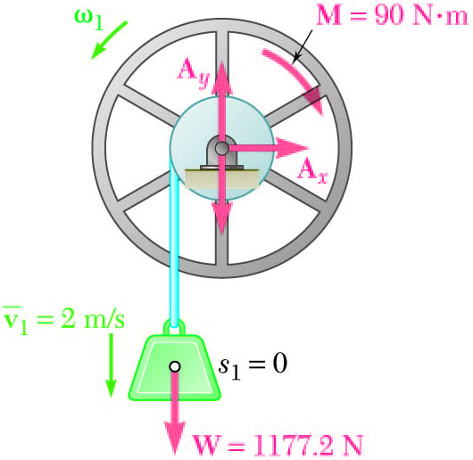
Sample Problem 17.1 3
Note that the block displacement and pulley rotation are related by
Then,
Principle of work and energy:

Slide 24
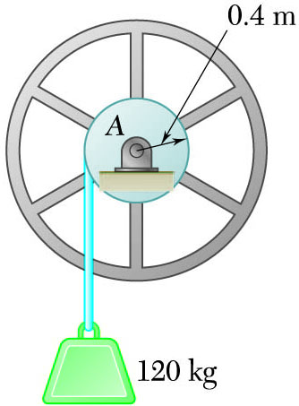
Sample Problem 17.1 4
Reflect and Think:
The speed of the block increases as it falls, but much more slowly than if it were in free fall. This seems like a reasonable result.
Rather than calculating the work done by gravity, you could have also treated the effect of the weight using gravitational potential energy, V_{g}.

Slide 25
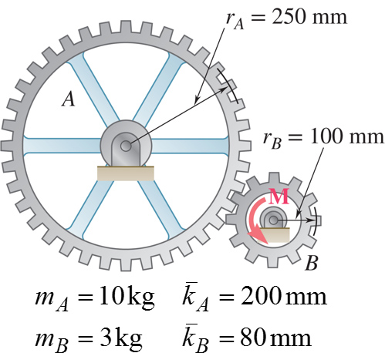
Sample Problem 17.2 1
Strategy:
Consider a system consisting of the two gears. Noting that the gear rotational speeds are related, evaluate the final kinetic energy of the system.
Apply the principle of work and energy. Calculate the number of revolutions required for the work of the applied moment to equal the final kinetic energy of the system.
The system is at rest when a moment of M=6 N · m is applied to gear B.
Neglecting friction, a) determine the number of revolutions of gear B before its angular velocity reaches 600 rpm, and b) tangential force exerted by gear B on gear A.
Apply the principle of work and energy to a system consisting of gear A. With the final kinetic energy and number of revolutions known, calculate the moment and tangential force required for the indicated work.

Slide 26
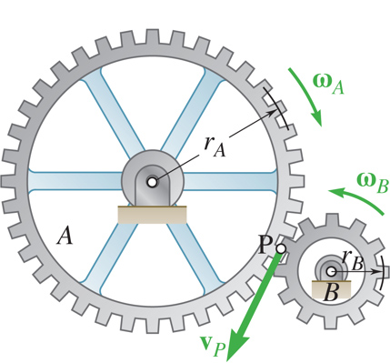
Sample Problem 17.2 2
Modeling and Analysis:
Consider a system consisting of the two gears. Noting that the gear rotational speeds are related, evaluate the final kinetic energy of the system.

Slide 27

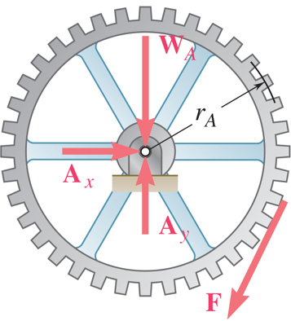
Sample Problem 17.2 3
Apply the principle of work and energy. Calculate the number of revolutions required for the work.
Apply the principle of work and energy to a system consisting of gear A. Calculate the moment and tangential force required for the indicated work.

Slide 28
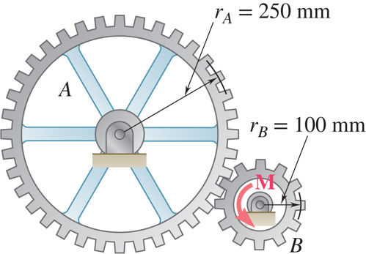
Sample Problem 17.2 4
Reflect and Think:
When the system was both gears, the tangential force between the gears did not appear in the work–energy equation, since it was internal to the system and therefore did no work. If you want to determine an internal force, you need to define a system where the force of interest is an external force. This problem, like most problems, also could have been solved using Newton’s second law and kinematic relationships.

Slide 29
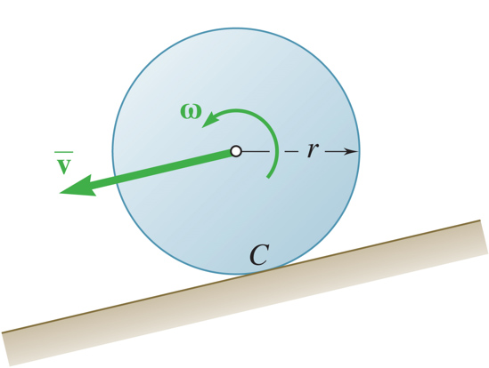
Sample Problem 17.3 1
Strategy:
The work done by the weight of the bodies is the same. From the principle of work and energy, it follows that each body will have the same kinetic energy after the change of elevation.
Because each of the bodies has a different centroidal moment of inertia, the distribution of the total kinetic energy between the linear and rotational components will be different as well.
A sphere, cylinder, and hoop, each having the same mass and radius, are released from rest on an incline. Determine the velocity of each body after it has rolled through a distance corresponding to a change of elevation h.

Slide 30
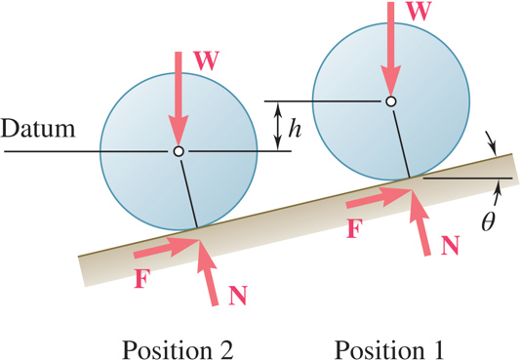
Sample Problem 17.3 2
Modeling and Analysis:
The work done by the weight of the bodies is the same. From the principle of work and energy, it follows that each body will have the same kinetic energy after the change of elevation.

Slide 31
Sample Problem 17.3 3
Because each of the bodies has a different centroidal moment of inertia, the distribution of the total kinetic energy between the linear and rotational components will be different as well.
NOTE:
For a frictionless block sliding through the same
distance,
The velocity of the body is independent of its mass and radius.
The velocity of the body does depend on

Slide 32
Sample Problem 17.3 4
Reflect and Think:
Let us compare the results with the velocity attained by a frictionless block sliding through the same distance. The solution is identical to the previous solution except that 𝜔 = 0; we find
Comparing the results, we note that the velocity of the body is independent of both its mass and radius. However, the velocity does
depend upon the quotient of
which measures the ratio of the rotational kinetic energy to the translational kinetic energy. Thus the hoop, which has the largest k for a given radius r, attains the smallest velocity, whereas the sliding block, which does not rotate, attains the largest velocity.

Slide 33
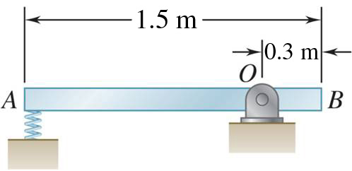
Sample Problem 17.4 1
Strategy:
The weight and spring forces are conservative. The principle of work and energy can be expressed as
T₁ + V₁ = T₂ + V₂
Evaluate the initial and final potential energy.
A 15-kg slender rod pivots about the point O. The other end is pressed against a spring (k = 300 kN/m) until the spring is compressed 25 mm and the rod is in a horizontal position.
If the rod is released from this position, determine its angular velocity and the reaction at the pivot as the rod passes through a vertical position.
Express the final kinetic energy in terms of the final angular velocity of the rod.
Based on the free-body-diagram equation, solve for the reactions at the pivot.

Slide 34
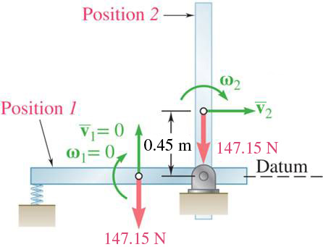
Sample Problem 17.4 2
Modeling and Analysis:
The weight and spring forces are conservative. The principle of work and energy can be expressed as
T₁ + V₁ = T₂ + V₂
Evaluate the initial and final potential energy.
Express the final kinetic energy in terms of the angular velocity of the rod.

Slide 35
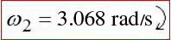
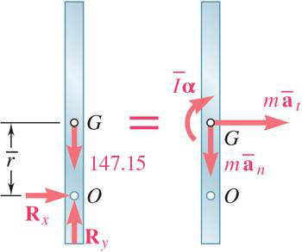
Sample Problem 17.4 3
From the principle of work and energy,
Based on the free-body-diagram equation, solve for the reactions at the pivot.

Slide 36

Sample Problem 17.4 4
Reflect and Think:
This problem illustrates how you might need to supplement the conservation of energy with Newton’s second law.
What if the spring constant had been smaller, say 30 kN/m? You would have found V_{e1} = 9.375 J and then solved to
obtain
This is clearly impossible and means that the rod would not make it to position 2 as assumed.

Slide 37
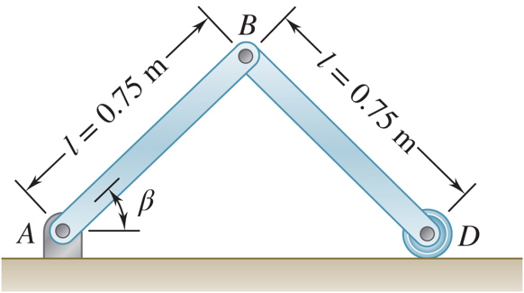
Sample Problem 17.6 1
Strategy:
Consider a system consisting of the two rods. With the conservative weight force,
Evaluate the initial and final potential energy.
Express the final kinetic energy of the system in terms of the angular velocities of the rods.
Each of the two slender rods has a mass of 6 kg. The system is released
from rest with
Solve the energy equation for the angular velocity, then evaluate the velocity of the point D.
Determine a) the angular velocity of
rod AB when
and b) the
velocity of the point D at the same instant.

Slide 38
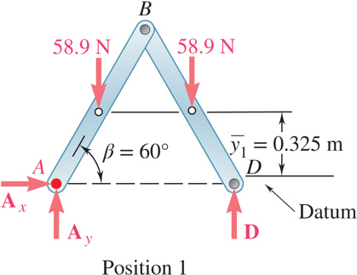
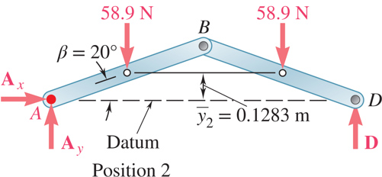
Sample Problem 17.6 2
Modeling and Analysis:
Consider a system consisting of the two rods. With the conservative weight force,
Evaluate the initial and final potential energy.

Slide 39
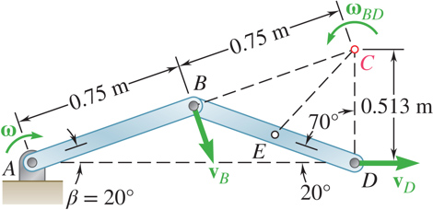
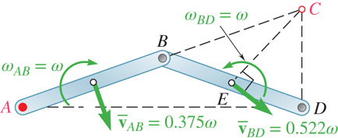
Sample Problem 17.6 3
Express the final kinetic energy of the system in terms of the angular velocities of the rods.
Since
is perpendicular to AB and
is horizontal,
the instantaneous center of rotation for rod BD is C.
BC = 0.75m
and applying the law of cosines to CDE, EC = 0.522 m
Consider the velocity of point B
For the final kinetic energy,

Slide 40

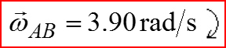
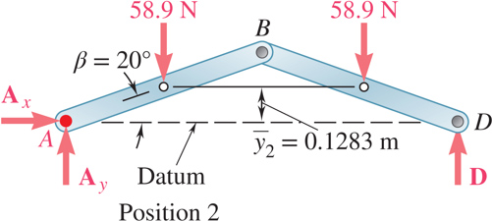
Sample Problem 17.6 4
Solve the energy equation for the angular velocity, then evaluate the velocity of the point D.
Reflect and Think: The only step in which you need to use forces is when calculating the gravitational potential energy in each position. However, it is good engineering practice to show the complete free-body diagram in each case to identify which, if any, forces do work. You could have also used vector algebra to relate the velocities of the various objects.

Slide 41
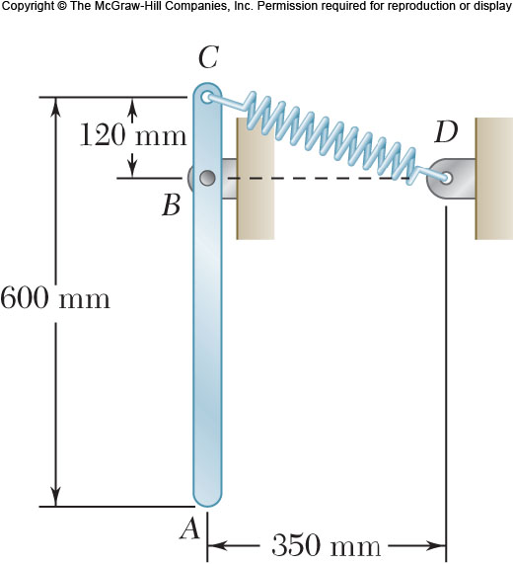
Group Problem Solving 1
Strategy:
Because the problem deals with positions and velocities, you should apply the principle of work energy.
Draw out the system at position 1 and position 2 and define your datum
Use the work-energy equation to determine the angular velocity at position 2
A slender 4-kg rod can rotate in a vertical plane about a pivot at B. A spring of constant k = 400 N/m and of unstretched length 150 mm is attached to the rod as shown. Knowing that the rod is released from rest in the position shown, determine its angular velocity after it has rotated through 90º.

Slide 42
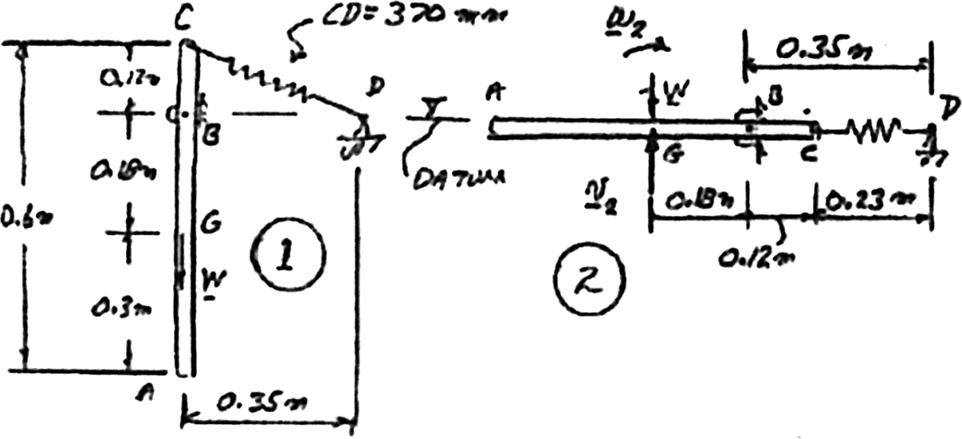
Group Problem Solving 2
Modeling and Analysis:
Draw your diagrams, set your datum and apply the work energy equation
Are any of the terms zero?

Slide 43

Group Problem Solving 3
Determine the spring energy at position 1
Determine the potential energy due to gravity at position 1
Determine the spring energy at position 2
Determine the potential energy due to gravity at position 2

Slide 44
Group Problem Solving 4
Determine an expression for T₂
Can you relate v₂ and ω₂?
Find I and substitute in to T₂
Substitute into T₁ + V₁ = T₂ + V₂

Slide 45
Concept Question 1
For the previous problem, how would you determine the reaction forces at B when the bar is horizontal?
a) Apply linear-momentum to solve for B_{x} Δt and B_{y} Δt.
b) Use work-energy to determine the work done by the moment at C.
c) Use sum of forces and sum of moments equations when the bar is horizontal.

Slide 46
Concept Question 2
For the previous problem, how would you determine the reaction forces at B when the bar is horizontal?
Apply linear-momentum to solve for B_{x}Δt and B_{y}Δt
Use work-energy to determine the work done by the moment at C
Use sum of forces and sum of moments equations when the bar is horizontal

Slide 47

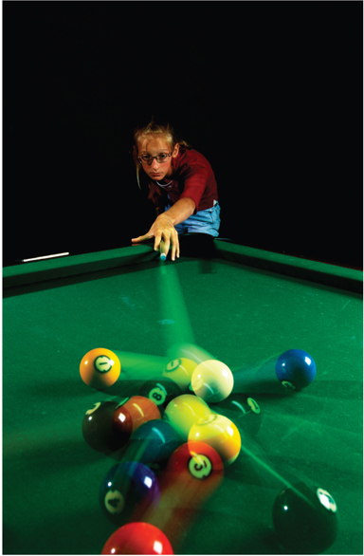
Angular Impulse Momentum
When two rigid bodies collide, we typically use principles of angular impulse momentum. We often also use linear impulse momentum (like we did for particles).
© Tetra Images/Alamy RF, © Richard T. Nowitz/Corbis

Slide 48
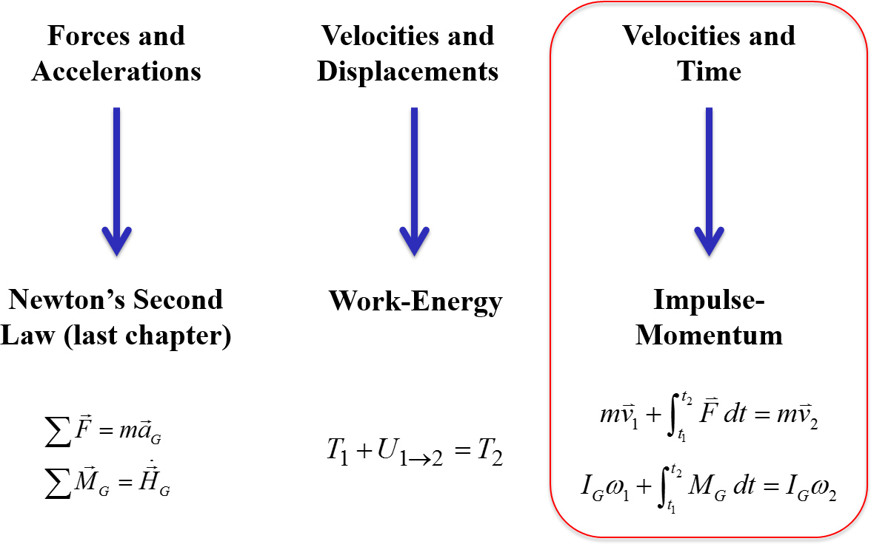
Introduction
Approaches to Rigid Body Kinetics Problems

Slide 49
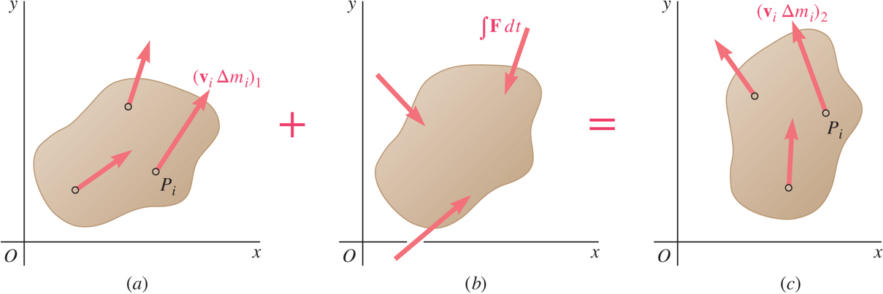
Principle of Impulse and Momentum 1
Method of impulse and momentum:
well suited to the solution of problems involving time and velocity
the only practicable method for problems involving impulsive motion and impact.
Sys Momenta₁ + Sys Ext Imp_{1 to 2} = Sys Momenta₂

Slide 50
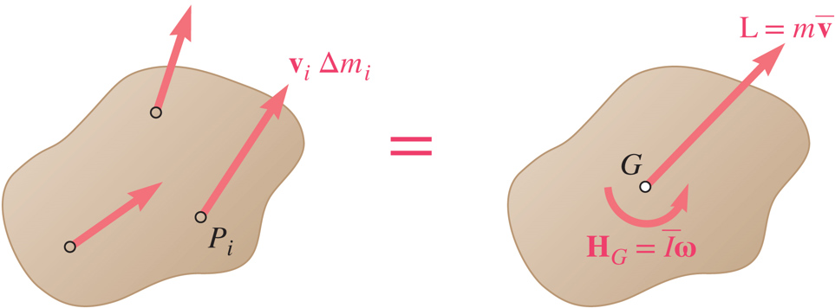
Principle of Impulse and Momentum 2
The momenta of the particles of a system may be reduced to a vector attached to the mass center equal to their sum,
and a couple equal to the sum of their moments about the mass center,
For the plane motion of a rigid slab or of a rigid body symmetrical with respect to the reference plane,

Slide 51
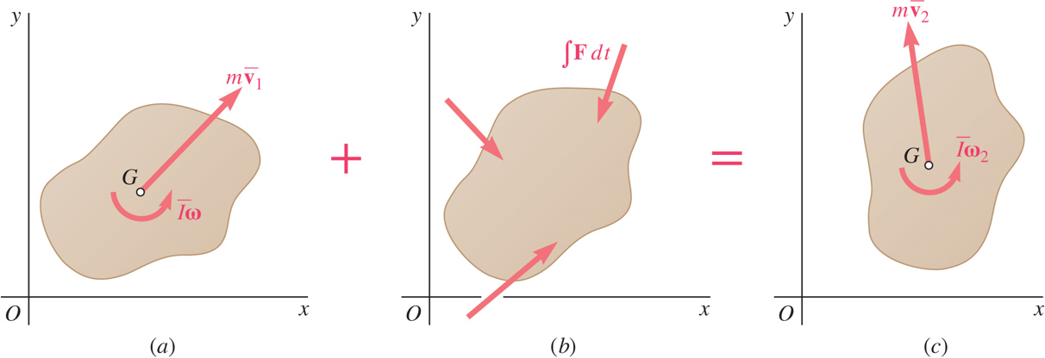
Principle of Impulse and Momentum 3
For plane motion problems, draw out an impulse-momentum diagram, (similar to a free-body diagram).
This leads to three equations of motion:
summing and equating momenta and impulses in the x and y directions.
summing and equating the moments of the momenta and impulses with respect to any given point (often choose G).

Slide 52

Impulse Momentum Diagrams 1
A sphere S hits a stationary bar AB and sticks to it. Draw the impulse-momentum diagram for the ball and bar separately; time 1 is immediately before the impact and time 2 is immediately after the impact.

Slide 53






Impulse Momentum Diagrams 2
Momentum of the ball before impact
Impulse on ball
Momentum of the ball after impact
Momentum of the bar before impact
Impulse on bar
Momentum of the bar after impact

Slide 54

Principle of Impulse and Momentum 4
Fixed axis rotation:
The angular momentum about O
Equating the moments of the momenta and impulses about O,
The pin forces at point O now contribute no moment to the equation

Slide 55
Systems of Rigid Bodies
Motion of several rigid bodies can be analyzed by applying the principle of impulse and momentum to each body separately.
For problems involving no more than three unknowns, it may be convenient to apply the principle of impulse and momentum to the system as a whole.
For each moving part of the system, the diagrams of momenta should include a momentum vector and/or a momentum couple.
Internal forces occur in equal and opposite pairs of vectors and generate impulses that cancel out.

Slide 56




Practice
From the previous problem, notice that the impulse acting on the sphere is equal and opposite to the impulse acting on the bar. We can take advantage of this by drawing the impulse-momentum diagram of the entire system, as shown on the next slide.

Slide 57






Practice – Diagram for combined system

Slide 58

Conservation of Angular Momentum 1
The moments acting through the skater’s center of gravity are negligible, so her angular momentum remains constant. She can adjust her spin rate by changing her moment of inertia.
© Jill Braaten

Slide 59
Conservation of Angular Momentum 2
When no external force acts on a rigid body or a system of rigid bodies, the system of momenta at t₁ is equipollent to the system at t₂. The total linear momentum and angular momentum about any point are conserved,
When the sum of the angular impulses pass through O, the linear momentum may not be conserved, yet the angular momentum about O is conserved,
Two additional equations may be written by summing x and y components of momenta and may be used to determine two unknown linear impulses, such as the impulses of the reaction components at a fixed point.

Slide 60

Concept Question 3
For the problem we looked at previously, is the angular momentum about G conserved?
Yes
No
For the problem we looked at previously, is the angular momentum about point A conserved?
Yes
No
For the problem we looked at previously, is the linear momentum of the system conserved?
Yes
No

Slide 61
Concept Question 4
For the problem we looked at previously, is the angular momentum about G conserved?
Yes
No
For the problem we looked at previously, is the angular momentum about point A conserved?
Yes
No
For the problem we looked at previously, is the linear momentum of the system conserved?
Yes
No

Slide 62

Sample Problem 17.7 1
Strategy:
Considering each gear separately, apply the method of impulse and momentum.
Solve the angular momentum equations for the two gears simultaneously for the unknown time and tangential force.
The system is at rest when a moment of M = 6N • m is applied to gear B.
Neglecting friction, a) determine the time required for gear B to reach an angular velocity of 600 rpm, and b) the tangential force exerted by gear B on gear A.

Slide 63


Sample Problem 17.7 2
Modeling and Analysis:
Considering each gear separately, apply the method of impulse and momentum.
moments about A:
moments about B:
Solve the angular momentum equations for the two gears simultaneously for the unknown time and tangential force.

Slide 64
Sample Problem 17.7 3
Reflect and Think:
This is the same answer obtained in Sample Prob. 17.2 by the method of work and energy, as you would expect. The difference is that in Sample Prob. 17.2, you were asked to find the number of revolutions, and in this problem, you were asked to find the time.
What you are asked to find will often determine the best approach to use when solving a problem.

Slide 65

Sample Problem 17.8 1
Strategy:
Apply principle of impulse and momentum to find variation of linear and angular velocities with time.
Relate the linear and angular velocities when the sphere stops sliding by noting that the velocity of the point of contact is zero at that instant.
Uniform sphere of mass m and radius r is projected along a rough horizontal surface with a linear
velocity
and no angular velocity.
The coefficient of kinetic friction is μ_{k}.
Substitute for the linear and angular velocities and solve for the time at which sliding stops.
Determine a) the time t₂ at which the sphere will start rolling without sliding and b) the linear and angular velocities of the sphere at time t₂.
Evaluate the linear and angular velocities at that instant.

Slide 66

Sample Problem 17.8 2
Modeling and Analysis:
Apply principle of impulse and momentum to find variation of linear and angular velocities with time.
Relate linear and angular velocities when sphere stops sliding by noting that velocity of point of contact is zero at that instant.
Sys Momenta₁ + Sys Ext Imp₁₋₂ = Sys Momenta₂
y components:
Substitute for the linear and angular velocities and solve for the time at which sliding stops.
x components:
moments about G:

Slide 67

Sample Problem 17.8 3
Evaluate the linear and angular velocities at that instant.
Sys Momenta₁ + Sys Ext Imp₁ _{to} ₂ = Sys Momenta₂
y components:
x components:
moments about G:
Reflect and Think:
This is the same answer obtained in Sample Prob. 16.6 by first dealing directly with force and acceleration and then applying kinematic relationships.

Slide 68

Sample Problem 17.9 1
Strategy:
Observing that none of the external forces produce a moment about the y axis, the angular momentum is conserved.
Equate the initial and final angular momenta. Solve for the final angular velocity.
Two solid spheres (radius = 100 mm, m = 1 kg) are mounted on a spinning horizontal rod ( ω = 6 rad/sec) as shown. The balls are held together by a string which is suddenly cut. Determine a) angular velocity of the rod after the balls have moved to A’ and B’, and b) the energy lost due to the plastic impact of the spheres and stops.
The energy lost due to the plastic impact is equal to the change in kinetic energy of the system.

Slide 69

Sample Problem 17.9 2
Modeling and Analysis:
Observing that none of the external forces produce a moment about the y axis, the angular momentum is conserved.
Equate the initial and final angular momenta. Solve for the final angular velocity.
Sys Momenta₁ + Sys Ext Imp₁₋₂ = Sys Momenta₂

Slide 70
Sample Problem 17.9 3
The energy lost due to the plastic impact is equal to the change in kinetic energy of the system.

Slide 71

Sample Problem 17.9 4
Reflect and Think:
As expected, when the spheres move outward, the angular velocity of the system decreases. This is similar to an ice skater who throws her arms outward to reduce her angular speed.

Slide 72

Group Problem Solving 5
Strategy:
Consider the projectile and bar as a single system. Apply the principle of impulse and momentum.
The moments about C of the momenta and impulses provide a relation between the final angular velocity of the rod and velocity of the projectile.
Use the principle of work-energy to determine the angle through which the bar swings.
A projectile weighing 40 g is fired with a horizontal velocity of 550 m/s into the lower end of a slender 7.5-kg bar of length L= 800 mm. Knowing that h= 300 mm and that the bar is initially at rest, determine the angular velocity of the bar when it reaches the horizontal position.

Slide 73

Group Problem Solving 6
Modeling and Analysis:
Draw the impulse momentum diagram
Apply the angular impulse momentum equation about point C
Given: W_{o}= (0.04 kg)(9.81 m/s²) = 0.3924 N, v_{o}= 550 m/s W_{AB} = (7.5 kg)(9.81 m/s²) = 73.575 N L= 0.8 m h= 0.3 m
Find: ω_{AB} when θ= 90º
Or you could use the relationship:

Slide 74

Group Problem Solving 7
Relate v_{B} and ω (after the impact)
Substitute into equation (1) and solve for ω
Find I_{C}
Substitute and solve

Slide 75
Group Problem Solving 8
Draw position 1 and 2, set your datum and apply the conservation of energy equation
B
2
DATUM
Find T₂
1
Find V₂
Solve for ω₃

Slide 76

Concept Question 5
For the previous problem, how would you determine the reaction forces at C when the bar is horizontal?
a) Apply linear-momentum to solve for C_{x}Δt and C_{y}Δt.
b) Use work-energy to determine the work done by the moment at C.
c) Use sum of forces and sum of moments equations when the bar is horizontal.

Slide 77
Concept Question 6
For the previous problem, how would you determine the reaction forces at C when the bar is horizontal?
a) Apply linear-momentum to solve for C_{x}Δt and C_{y}Δt.
b) Use work-energy to determine the work done by the moment at C.
c) Use sum of forces and sum of moments equations when the bar is horizontal.

Slide 78
Concept Question 7
For the previous problem, what would happen if the coefficient of restitution between the projectile and bar was 1.0 instead of zero?
a) The angular velocity after impact would be bigger.
b) The angular velocity after impact would be smaller.
c) The angular velocity after impact would be the same.
c) Not enough information to tell.

Slide 79
Concept Question 8
For the previous problem, what would happen if the coefficient of restitution between the projectile and bar was 1.0 instead of zero?
a) The angular velocity after impact would be bigger.
b) The angular velocity after impact would be smaller.
c) The angular velocity after impact would be the same.
d) Not enough information to tell.

Slide 80



Eccentric Impact
Period of deformation
Period of restitution
Principle of impulse and momentum is supplemented by
These velocities are for the points of impact

Slide 81

Concept Question 9
The cars collide, hitting at point P as shown. Which of the following can you use to help analyze the collision?
a) The linear momentum of car A is conserved.
b) The linear momentum of the combined two cars is conserved
c) The total kinetic energy before the impact equals the total kinetic energy after the impact
d) The angular momentum about the CG of car B is conserved

Slide 82
Concept Question 10
The cars collide, hitting at point P as shown. Which of the following can you use to help analyze the collision?
a) The linear momentum of car A is conserved.
b) The linear momentum of the combined two cars is conserved
c) The total kinetic energy before the impact equals the total kinetic energy after the impact
d) The angular momentum about the CG of car B is conserved

Slide 83

Sample Problem 17.11 1
Strategy:
Consider a system consisting of the bullet and panel. Apply the principle of impulse and momentum.
The final angular velocity is found from the moments of the momenta and impulses about A.
The reaction at A is found from the horizontal and vertical momenta and impulses.
A 25-g bullet is fired into the side of a 10-kg square panel which is initially at rest.
Determine a) the angular velocity of the panel immediately after the bullet becomes embedded and b) the impulsive reaction at A, assuming that the bullet becomes embedded in 0.0006 s.

Slide 84

Sample Problem 17.11 2
Modeling and Analysis:
Consider a system consisting of the bullet and panel. Apply the principle of impulse and momentum.
The final angular velocity is found from the moments of the momenta and impulses about A.
moments about A:

Slide 85
Sample Problem 17.11 3
The reactions at A are found from the horizontal and vertical momenta and impulses.
Reflect and Think:
The speed of the bullet is in the range of a modern high-performance rifle. Notice that the reaction at A is over 5000 times the weight of the bullet and over 10 times the weight of the plate.
x components:
y components:

Slide 86

Sample Problem 17.13 1
Strategy:
Consider the sphere and rod as a single system. Apply the principle of impulse and momentum.
The moments about A of the momenta and impulses provide a relation between the final angular velocity of the rod and velocity of the sphere.
A 2-kg sphere with an initial velocity of 5 m/s strikes the lower end of an 8-kg rod AB. The rod is hinged at A and initially at rest. The coefficient of restitution between the rod and sphere is 0.8.
Determine the angular velocity of the rod and the velocity of the sphere immediately after impact.
The definition of the coefficient of restitution provides a second relationship between the final angular velocity of the rod and velocity of the sphere.
Solve the two relations simultaneously for the angular velocity of the rod and velocity of the sphere.

Slide 87


Sample Problem 17.13 2
Modeling and Analysis:
Consider the sphere and rod as a single system. Apply the principle of impulse and momentum.
The moments about A of the momenta and impulses provide a relation between the final angular velocity of the rod and velocity of the rod.

Slide 88


Sample Problem 17.13 3
The definition of the coefficient of restitution provides a second relationship between the final angular velocity of the rod and velocity of the sphere.
Solve the two relations simultaneously for the angular velocity of the rod and velocity of the sphere.
Reflect and Think
The negative value for the velocity of the sphere after impact means that it bounces back to the left. Given the masses of the sphere and the rod, this seems reasonable
Solving,

Slide 89

Sample Problem 17.14 1
Strategy:
Apply the principle of impulse and momentum to relate the velocity of the package on conveyor belt A before the impact at B to the angular velocity about B after impact.
A square package of mass m moves down conveyor belt A with constant velocity. At the end of the conveyor, the corner of the package strikes a rigid support at B. The impact is perfectly plastic.
Derive an expression for the minimum velocity of conveyor belt A for which the package will rotate about B and reach conveyor belt C.
Apply the principle of conservation of energy to determine the minimum initial angular velocity such that the mass center of the package will reach a position directly above B.
Relate the required angular velocity to the velocity of conveyor belt A.

Slide 90


Sample Problem 17.14 2
Modeling and Analysis:
Apply the principle of impulse and momentum to relate the velocity of the package on conveyor belt A before the impact at B to angular velocity about B after impact.

Slide 91


Sample Problem 17.14 3
Apply the principle of conservation of energy to determine the minimum initial angular velocity such that the mass center of the package will reach a position directly above B.
(solving for the minimum w₂)

Slide 92
Sample Problem 17.14 4
Reflect and Think:
The combination of energy and momentum methods is typical of many design analyses. If you had been interested in determining the reaction at B immediately after the impact or at some other point in the motion, you would have needed to draw a free-body diagram and kinetic diagram and apply Newton’s second law.

Slide 93

Group Problem Solving 9
Strategy:
Consider the sphere and panel as a single system. Apply the principle of impulse and momentum.
The moments about A of the momenta and impulses provide a relation between the angular velocity of the panel and velocity of the sphere.
Use the principle of work-energy to determine the angle through which the panel swings.
An 8-kg wooden panel P is suspended from a pin support at A and is initially at rest. A 2-kg metal sphere S is released from rest at B′ and falls into a hemispherical cup C′ attached to the panel at the same level as the mass center G. Assuming that the impact is perfectly plastic, determine the angular velocity of the panel immediately after the impact.

Slide 94

Group Problem Solving 10
Modeling and Analysis:
Draw the impulse momentum diagram
Apply the angular impulse momentum equation about point A
Given: m_{S}= 2 kg, m_{P} = 8 kg, h_{S}= 0.250 m, e= 0.
Find: Angle θ through which the panel and sphere swing after the impact
H_{A} of sphere before impact
H_{A} of panel after impact
H_{A} of sphere after impact

Slide 95

Group Problem Solving 11
Determine velocity of sphere at impact (v_{S})₁
You can apply work-energy or kinematics
Determine velocity of sphere after impact in terms of ω₂

Slide 96
Group Problem Solving 12
Determine mass moment of inertia for panel
Substitute into H equation and solve for ω₂

Slide 97
Concept Question 11
For the previous problem, what would you do if you wanted to determine how high up the panel swung after the impact?
a) Apply linear-momentum to solve for mv_{G}
b) Use work-energy and set T_{final} equal to zero
c) Use sum of forces and sum of moments equations

Slide 98
Concept Question 12
For the previous problem, what would you do if you wanted to determine how high up the panel swung after the impact?
Apply linear-momentum to solve for mv_{G}
Use work-energy and set T_{final} equal to zero
Use sum of forces and sum of moments equations

Slide 99
Concept Question 13
For the previous problem, what if the ball was dropped closer to point A (example: at x= 100 mm instead of 200 mm)?
a) The angular velocity after impact would be bigger
b) The angular velocity after impact would be smaller
c) The angular velocity after impact would be the same
d) Not enough information to tell

Slide 100
Concept Question 14
For the previous problem, what if the ball was dropped closer to point A (e.g., at x= 100 mm instead of 200 mm)?
The angular velocity after impact would be bigger
The angular velocity after impact would be smaller
The angular velocity after impact would be the same
Not enough information to tell

Slide 101
End of Chapter 17

